Slide 1
GDGoC HITAM • AGENTIC AI HACKATHON
PROJECT
PRESENTATION
WASTE NOT,ROT NOT 🍅
INSIGHT MINERS

Slide 2
AGENTIC AI HACKATHON | GDGoC HITAM
02 / 07
Team Details
Team Name
INSIGHT MINERS
Team Leader
K.GIRISH,Girishgtavm@gmail.com,9347073364
Team Members
E.ANUSHKA YADAV,24e51a6744@hitam,8247732565
C.RIKITHA,24e51a6734@hitam.org,6304769367
College Name
HITAM
Team Contact
9347073364
GDGoC HITAM • Agentic AI Hackathon

Slide 3


AGENTIC AI HACKATHON | GDGoC HITAM
03 / 07
Problem Statement
Selected Problem Statement
Zero-Waste Grocery-An Agentic AI Approach to Perishable Demand & Shelf-Life Management
Understanding about the Problem Statement
What is the problem?
Grocery stores often struggle to predict how much fresh food customers will buy and when will the food stored will get expired .
Overstocking leads to food wastage while understocking leads to unhappy customers and missed amount of sales
Why is this problem important and unique?
Complex decisions are to be taken by the stores when to reorder stock, discounts, or retain existing stocks
Unpredictable demand of the customers makes it difficult for the store to analyze the customer trends and replenish the stock
Environmental impact : expired products leads to wastage of food and affects the mankind and the living of the society and may cause inflammation
Who benefits from the solution and how?
Grocery stores, customers, inventory managers, society will benefit from our solution
Our solution uses Agentic AI to forecast demand, identify spoilage risks, and recommend smarter inventory decisions.
It compares possible actions and provides explainable recommendations for store planners to review and approve.
it enables AI driven decisions and make the beneficiaries understand it clearly
GDGoC HITAM • Agentic AI Hackathon

Slide 4

AGENTIC AI HACKATHON | GDGoC HITAM
04 / 07
Proposed Solution
Solution Overview
Our website uses Agentic AI to forecast grocery demand, monitor inventory, and identify products at risk of spoilage.
It recommends smart discounts, stock transfers, and replenishment to reduce food waste, prevent stockouts, and improve profitability.
Store planners can review and approve recommendations before implementation.
NOVELITY : In all other existing solutions one agent works at a time but our agents work together to make expiry aware and inventory decisions rather than depending on pre fixed rules or dates for reordering stock and products
So therefore it also makes the society living good and also contributes to the environment by stopping wastage of food and using it efficiently.
Key Features
Demand forecasting
Expiry risk detection
Smart discounts and stock transfers
Inventory optimization
Human-in-the-loop AI provides explainable recommendations for planner approval before execution.
Where Agentic AI Fits
Demand forecasting agent
Spoilage risk agent
Inventory decision agent
Allows the store planner to review and approve decisions before implementation.
Workflow / User Journey
Upload Data → Analyze Demand & Expiry → Compare Actions → Generate Recommendation → Planner Approves → Track Results
GDGoC HITAM • Agentic AI Hackathon

Slide 5
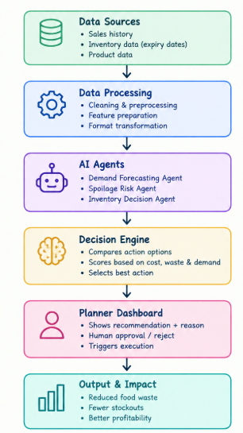
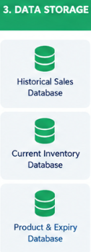

AGENTIC AI HACKATHON | GDGoC HITAM
05 / 07
System Architecture
Technology Stack
Language: Python
Libraries: Pandas, NumPy, Scikit-learn
Dashboard: Streamlit, Plotly
Data: CSV files / simulated POS, WMS, ERP data
Agent Flow & Guardrails
Inputs → Data Cleaning → AI Agents → Decision Engine → Planner Approval
Guardrails: Business rules, stock constraints, and human approval.
Evaluation: Track food waste, stockouts, costs, and forecast accuracy.
GDGoC HITAM • Agentic AI Hackathon

Slide 6
AGENTIC AI HACKATHON | GDGoC HITAM
06 / 07
Prototype Screenshots & Project Links
Insert clear screenshots of your working prototype and add short captions (if-any).
GDGoC HITAM • Agentic AI Hackathon

Slide 7
GDGoC HITAM • AGENTIC AI HACKATHON
THANK YOU
WASTE NOT, ROT NOT 🍅
Team Name: INSIGHT MINERS
GitHub: [URL]
Live Demo: [URL]

